Slide 1
SOFTWARE REENGINEERING
1

Slide 2
OO Reengineering Patterns
What is a pattern
What is an OOR Pattern
Setting direction

Slide 3
OO Legacy System!!
3
 Any successful software system will suffer from the symptoms of legacy systems. Object-oriented legacy systems are just successful object-oriented systems whose architecture and design no longer responds to changing requirements
Notes:
A legacy system is a computer system, software, or hardware that is based on old or outdated technology¹²³⁴. It is still in use, but it may not meet the current or future needs of the user or organization¹⁴⁵. It may also have problems with compatibility, support, or terminology²³⁵. A legacy system can be a previous or outdated
standard that was replaced by a newer one
Object-oriented refers to a programming language, system or software methodology that is built on the concepts of logical objects. It works through the creation, utilization and manipulation of reusable objects to perform a specific task, process or objective.

Slide 4
OO System Problems!
4
The most common ﬁne-grain problems occurring in object-oriented software include:
Misuse of inheritance: for composition, code reuse rather than polymorphism
Missing inheritance: duplicated code, and case statements to select behavior
Misplaced operations: unexploited cohesion—operations outside instead of inside classes
Violation of encapsulation: explicit type-casting, C++ “friends” .
Class abuse: lack of cohesion—classes as namespaces

Slide 5
Patterns
5
Patterns as a literary form were introduced by the architect Christopher Alexander in his landmark 1977 book, "A Pattern Language".
In this book, Alexander and his colleagues presented a systematic method for architecting a range of different kinds of physical structures, from rooms to buildings and towns.

Slide 6
6
Software Patterns
 Patterns were ﬁrst adopted by the software community as a way of documenting recurring solutions to design problems.
Notes:
Recurring occurring again periodically or repeatedly.

Slide 7
Reengineering Patterns
7
We see reengineering patterns as stable units of expertise which can be consulted in any reengineering effort: they describe a process without proposing a complete methodology, and they suggest appropriate tools without “selling” a speciﬁc one.
Reengineering patterns codify and record knowledge about modifying legacy software:
they help in diagnosing problems and identifying weaknesses which may delay further development of the system.
They aid in ﬁnding solutions which are more appropriate to the new requirements.

Slide 8
Design vs Reengineering Patterns
Whereas a design pattern presents a solution for a frequent design problem, a reengineering pattern presents a solution for a frequent reengineering problem.
There is an importance difference in that design patterns have to do with choosing a particular solution to a design problem, whereas reengineering patterns have to do with discovering an existing design, determining what problems it has, and repairing these problems.
Reengineering patterns have more to do with the process of discovery and transformation than purely with a given design structure.

Slide 9
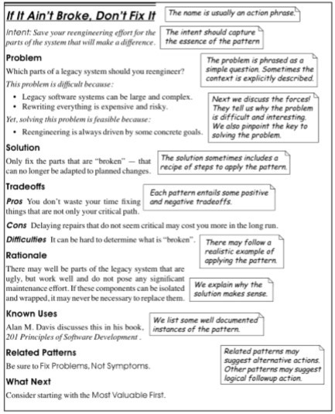

Slide 10

Reverse Engineering
 What and Why
Setting Direction
Most Valuable First
First Contact
Chat with the Maintainers
Interview during Demo
Initial Understanding
Analyze the Persistent Data
Study Exceptional Entities

Slide 11
What and Why ?
Definition
Reverse Engineering is the process of analysing a subject system
to identify the system’s components and their interrelationships and
create representations of the system
in another form or
at a higher level of abstraction.
— Chikofsky & Cross, ’90
Motivation
Understanding other people’s code
 newcomers in the team,
 code reviewing
 original developers left
Generating UML diagrams is NOT reverse engineering
... but it is a valuable support tool

Slide 12






The Reengineering Life-Cycle
Requirements
(0) requirement analysis
(2) problem detection
(3) problem resolution
Designs
req. analysis
model capture
issues
scale
speed
accuracy
politics
(1) model capture
Code
(4) program transformation

Slide 13
Setting Direction
Conflicting interests
technical, ergonomic, economic, political
Presence/absence original developers
Legacy architecture
not the best
Which problems to tackle?
Interesting vs. important problems?
Wrap, refactor or rewrite?

Slide 14
Setting Direction
Set direction
Agree on Maxims
Coordinate direction
Where to start
Maintain direction
Most Valuable First
Appoint a Navigator
Speak to the Round Table
What to do
What not to do
Fix Problems, Not Symptoms
If It Ain't Broke Don't Fix It
Principles & Guidelines for Software project management
especially relevant for reengineering projects
How to do it
Keep it Simple

Slide 15
Most Valuable First
Problem: Which problems should you focus on first?
Solution: Work on aspects that are most valuable to your customer
Maximize commitment, early results
build confidence
Difficulties and hints:
Which stakeholder do you listen to?
What measurable goal to aim for?
Consult change logs for high activity
Play the Planning Game

Slide 16
First Contact
Where Do I Start?
Legacy systems are large and complex
Split the system into manageable pieces
Time is limited
Apply lightweight techniques to assess feasibility and risks
First impressions are dangerous
Always double-check your sources

Slide 17
First Contact
System experts
Talk with developers
Chat with the Maintainers
Talk with end users
Interview during Demo
Talk about it
Software System Read
about it
Verify what you hear
Read it
Compile it
Read All the Code in One Hour
Skim the Documentation
Do a Mock Installation

Slide 18
Chat with the Maintainers
Problem: What are the history and politics of the legacy system?
Solution: Discuss the problems with the system maintainers.
Documentation will mislead you (various reasons)
Stakeholders will mislead you (various reasons)
The maintainers know both the technical and political history

Slide 19
Chat with the Maintainers
Questions to ask:
Easiest/hardest bug to fix in recent months?
How are change requests made and evaluated?
How did the development/maintenance team evolve during the project?
How good is the code? The documentation?
Why was the reengineering project started? What do you hope to gain?
Themajorproblemsofourworkarenotsomuchtechnologicalas sociological.
DeMarco and Lister, Peopleware

Slide 20
Read all the Code in One
Problem: How can you get first impression of the quality of the
source code?
Solution: Scan all the code in single, short session.
Use a checklist
 code review guidelines, coding styles etc.
Look for functional tests and unit tests
Look for abstract classes and root classes that define domain abstractions
Beware of comments
Log all your questions!
I took a course in speed reading and read “War and Peace” in twenty minutes. It’s about Russia.
Woody Allen

Slide 21
Read all the Code in One
Pros
 Start efficiently
 code review guidelines, coding styles etc.
Judge sincerely
 unbiased view of the software
Learn the developer’s vocabulary
Cons
Obtain low abstraction
Doest no scale
Comments may mislead you

Slide 22
Initial Understanding
Data is unreliable
Always double-check your sources
Understanding needs of iteration
Plan iteration and feedback loops
Knowledge must be shared
“Put the map on the wall”
Teams need to communicate
“Use their language”

Slide 23
Initial Understanding
Top down
Recover design
Speculate about Design
understand ⇒
higher-level model
Analyze the Persistent Data
Study the Exceptional Entities
Recover database
Identify problems
Bottom up

Slide 24
Analyze the Persistent Data
Problem: Which objects represent valuable data? Solution: Analyze the database schema
Prepare Model
tables ⇒ classes; columns ⇒ attributes
primary keys
naming conventions + unique indices
foreign keys (associations between classes)
be aware of synonyms and homonyms
Incorporate Inheritance
one to one; rolled down; rolled up
Incorporate Associations
association classes (e.g. many-to-many

Slide 25
Example: One To One
Person
id: char(5) name: char(40)
addresss: char(60)
Person
id: char(5) name: char(40)
addresss: char(60)
Salesman id: char(5)
company: char(40)
Patient
id: char(5) insuranceID: char(7) insurance: char(5)
Salesman
id: char(5) company: char(40)
Patient id: char(5) insuranceID: char(7) insurance: char(5)

Slide 26
Example: Rolled Down
Salesman
Patient
id: char(5) name: char(40)
addresss: char(60) company: char(40)
id: char(5) name: char(40)
addresss: char(60) insuranceID: char(7) insurance: char(5)
Person
id: char(5) name: char(40)
addresss: char(60)
Patient id: char(5) insuranceID: char(7) insurance: char(5)
Salesman
id: char(5) company: char(40)

Slide 27
Example: Rolled Up
Person
Person
id: char(5)
id: char(5) name: char(40)
addresss: char(60)
name: char(40) addresss: char(60)
kind: integer
insuranceID: char(7) «optional» insurance: char(5) «optional» company: char(40) «optional»
Salesman
id: char(5) company: char(40)
Patient id: char(5) insuranceID: char(7) insurance: char(5)

Slide 28
Study the Exceptional Entities
Problem: How can you quickly identify design problems?
Solution: Measure software entities and study the anomalous ones
Use simple metrics
Visualize metrics to get an overview
Browse the code to get insight into the anomalies

Slide 29
Questions
Which tools to use?
Which metrics to collect?
Which thresholds to apply
How to interpret the results?
How to identify anomalies quickly?
Should I trust numbers?
What about normal entities?

Slide 30
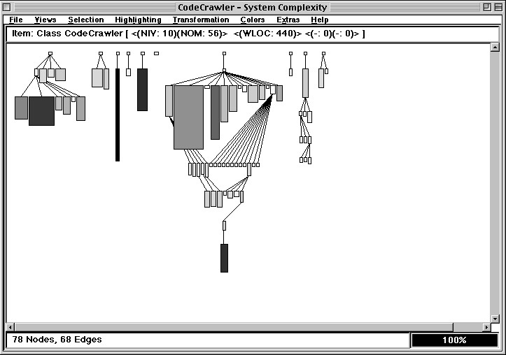
CodeCrawler: Visualizing Metrics
Use simple metrics and layout algorithms.
colour
height
(x,y)
width
Visualize up to 5 metrics per node

Slide 31
Initial Understanding (revisited) _{T op down}
Recover design
Speculate about Design
ITERATION
understand ⇒
higher-level model
Analyze the Persistent Data
Study the Exceptional Entities
Recover database
Identify problems
Bottom up

Slide 32
Thanks for your attention!

